Slide 1
Orientation to the RCY
For Prospective Deputy Representative Applicants
May 27th 2021

Slide 2
Notes:
Acknowledgement of the territories and the history of the peoples on whose traditional lands our offices are located – the Lekwungen speaking peoples in Victoria (Esquimalt and Songhees Nations), the Tsleil Waututh, Qayqayt, Sto:lo, Musqueam peoples in Burnaby, and the Lheidl T’enneh and Dakel in Prince George

Slide 3
Presentation second page
Agenda
About the RCY – origins to current context
About the Deputy Representative role
Spotlights
Reviews and Investigations
Monitoring
Corporate Services
Recruitment process – what to expect
Notes:
To review the overall approach to recommendations formation and progress monitoring, toward improved efficiency and effectiveness for both the RCY and Ministries. The ultimate goal is to ensure that the process focuses our collective attention on impacts.
Notes:
We truly want to know if we are making progress – and others are too
We want to keep our collective energy on making a difference rather than “busy work
Measuring outcomes more effectively is something we are all being called to do – we would like to learn from some of your thinking and work
Our intention:
We want to reduce ambiguity and ensure that the intentions of our rec’s are clear
Once we are clear on our intention, we believe ministries have the best sense of the actions that will get us where we need to get to
Our intention is to make a meaningful difference in the lives of children and youth
We would like to ensure that our recommendations formed in a way that takes existing work taking place in ministries into account
And we have a responsibility to track a and measure progress – this is our accountability

Slide 4
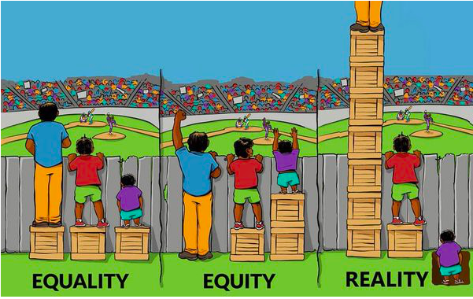

Slide 5
Our Origins Honourable Ted Hughes

Slide 6
Our Origins
Honourable Hughes recommended that the Representative work to:
“assist, encourage, and sometimes prod the government to be more aware and responsive to the individual concerns of children, youth and families …” and
“…recommend changes that will address broader problems in the child welfare system.”
He stressed the importance of the independence of this Office and believed that the RCY must be “an independent voice for vulnerable children and youth in B.C.”

Slide 7
Our Purpose
The Office of the Representative for Children and Youth is an independent advocacy and oversight body that champions fundamental rights and promotes improvements in services for vulnerable children, youth and young adults.

Slide 8
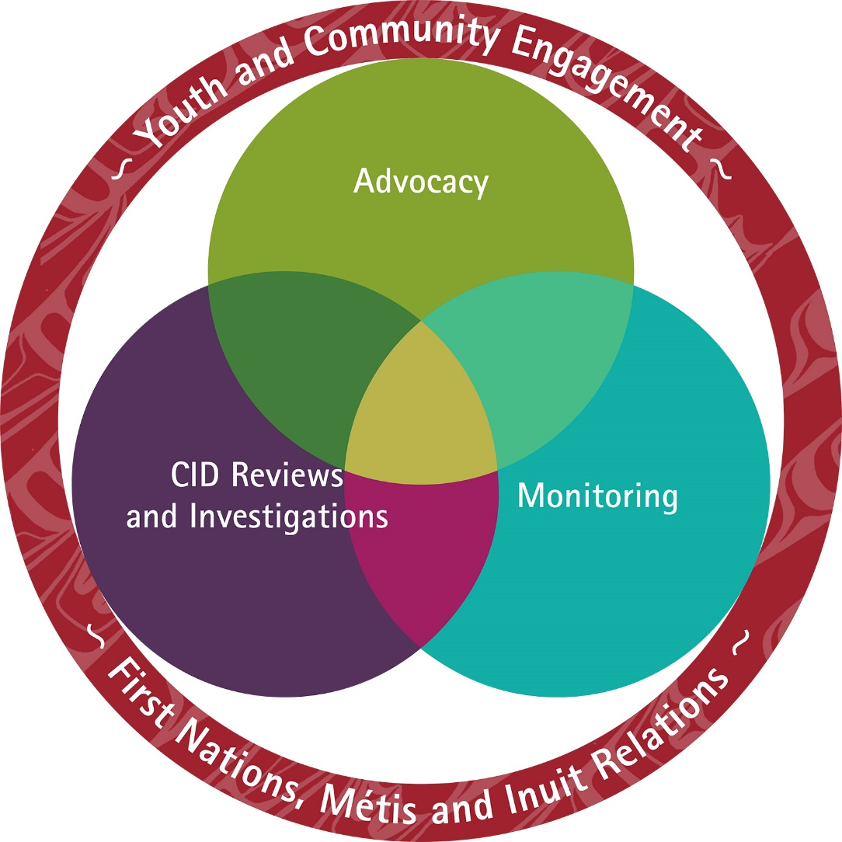
Who we are
75+ staff (including OHRC Shared services)
4 locations + telework
Diverse backgrounds
Who we serve
Children and youth up to age 19 eligible for or receiving services through MCFD + some health services
19-23 years olds eligible for or receiving services from CLBC or on Agreement with Young Adults or Tuition Waiver

Slide 9
Designated and Reviewable Services
Under the Representative for Children and Youth Act, ‘designated services ‘ are services under the Adoption Act, Child Care Act, Child Care Subsidy Act, Community Living Authority Act, CFCSA and Youth Justice Act + ECD and child care, mental health, addictions services and transitions for youth and young adults. These are the focus for advocacy services.
‘Reviewable services’ are services under the CFCSA and YJA + mental health and addictions services. These are the focus for critical injury and death reviews.
Notes:
But under our monitoring mandate we can address any issue that is pertinent to the well being of children and youth- education, family law, racism, cyberbullying

Slide 10
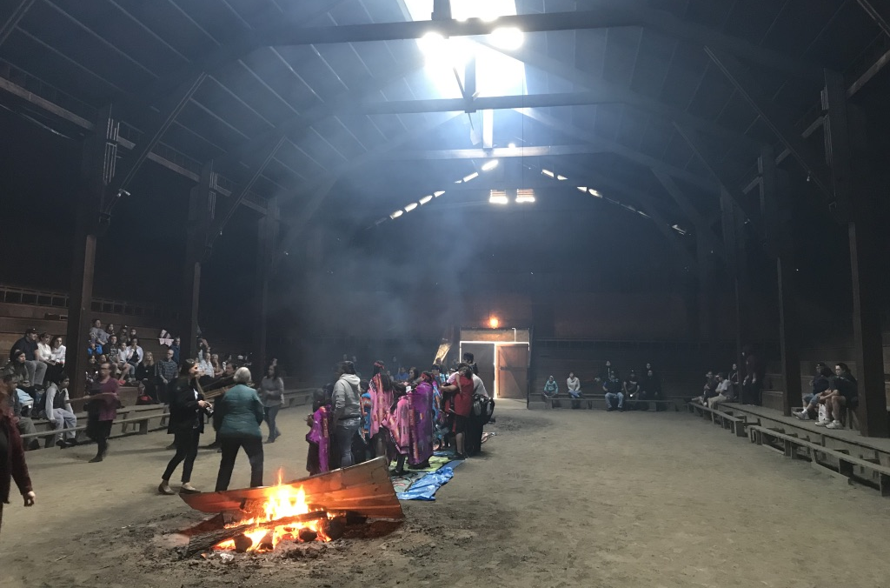
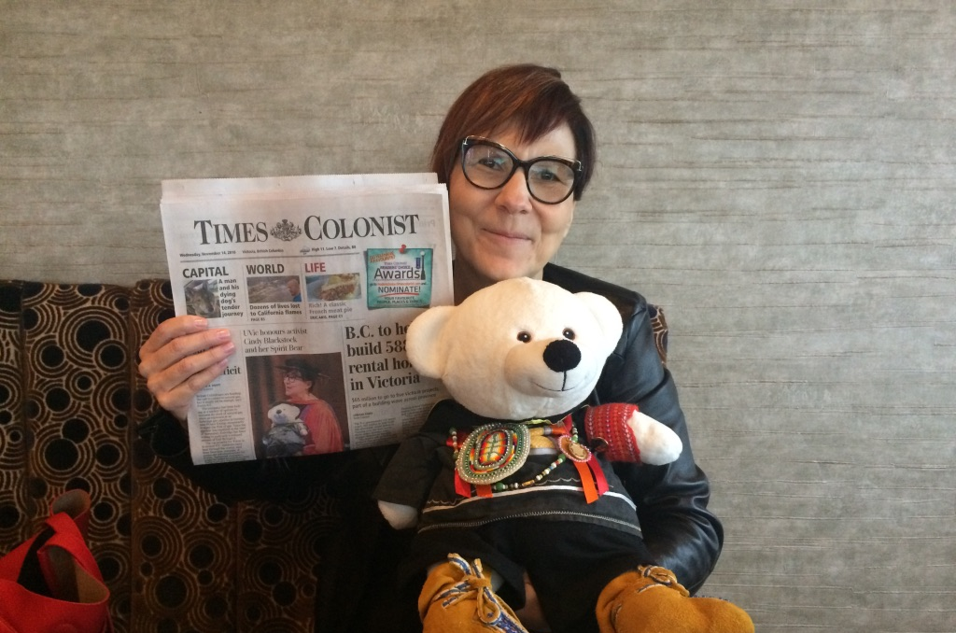
Evolving Context for the Work
The time we are in…growing awareness and understanding of colonization and its ongoing impacts, implicit and explicit racism
An Act respecting First Nations, Inuit and Metis children, youth and families
UNDRIP and DRIPA legislation
TRC Calls to Action
MMIWG Calls for Justice
CHRT Rulings
Indigenous Resilience, Connectedness and Reunification Report
Agreements and commitments between RCY and FNLC, MNBC, DAAs, and BCAAFC

Slide 11
Holding the Tensions
First Nations, Metis, Inuit and urban Indigenous children and youth are significantly overrepresented in the child welfare and youth justice systems
The RCY is a creation of a colonial system; we carry significant power
How do we do our work in a way that is more culturally attuned and responsive?
How do we hold the tensions of being part of a big system, while trying to fundamentally change it?
How might we seek guidance and direction from Indigenous children, youth, families, leaders and communities about what changes are called for?
How do we work in relational ways while also maintaining independence?

Slide 12
How we do our work: The 6 Rs

Slide 13
Internal work no blame and shame; embrace a philosophy of inclusion, diversity and collaboration
Recruitment priorities
Retention strategies
Four principles learning and applications: complexity; trauma and resistance; restorative approaches; cultural safety; anti-racism
Indigenous ways of knowing and being
Examining all our practices through a lens of cultural humility – and committing to changing ourselves personally and organizationally
Supporting staff through supervision, training and inclusion
Calling in – not calling out

Slide 14
External work
Building, sustaining and amplifying relationships with First Nations, Metis and urban Indigenous leadership
Seeking counsel
Saying ‘yes’ when asked to be in community; being present
Bearing witness; being curious and open to critique
Consulting on our reports
Telling the story in mainstream contexts
Notes:
W

Slide 15
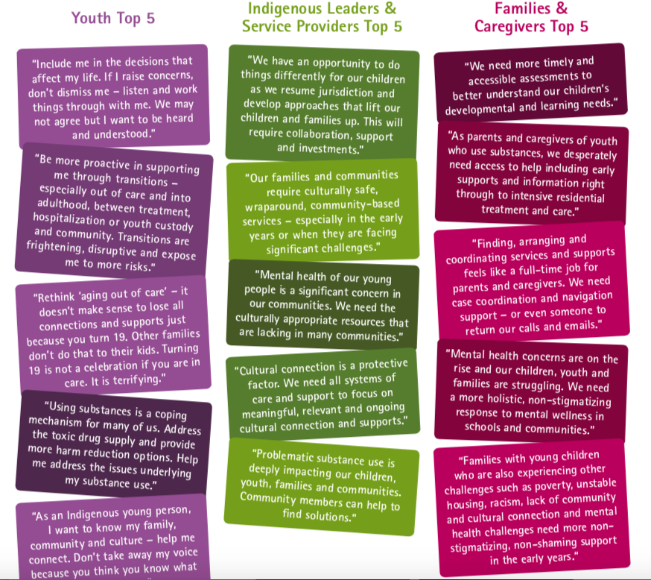
Notes:
Community guidance:
Prevention and early intervention services (e.g. support for families, early interventions for mental health and substance use concerns, wraparound supports)
Accessible, equitable, timely and relevant services for CYSN and their families
Planning and supports for transitions to adulthood
Listen to and honour youth voice
Cultural connection and safety
Support for First Nation and Metis resumption of jurisdiction
Illuminate and address the underlying systemic and structural issues that harm children and families

Slide 16
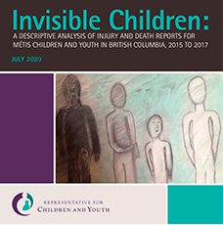
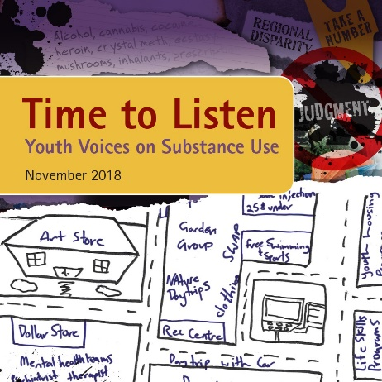
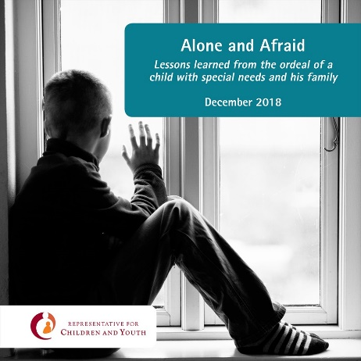

Slide 17
How we do the work
Layering multiple strategies and opportunities, all of which are aligned towards advancing systemic change in core areas.
Strategies and opportunities include:
Internal advocacy – “quiet conversations”
Reports
Presentations to SSCCY and other parliamentary committees
Monitoring of recommendations and progress
Oversight and feedback e.g. CYSN framework
Collaborative initiatives or research
Information sharing, knowledge mobilization and exchanges
Convening/hosting
Showcasing the work of others that is aligned with RCY priorities
Showcasing brightspots and promising practices and research
Presentations and outreach
Position statements
OpEds and media

Slide 18
Themes and Priorities
Children and youth with special needs
Child and youth mental health
Youth and young adults in transition
Children’s voice and rights
Supporting families and young children
Complex lives and care

Slide 19
Themes and Priorities
7. Residential care
8. Substance use
9. Family violence, Gender-based violence
10. Illuminating cultural connections and supports for belonging
11. Enhancing access to data and knowledge

Slide 20
Complexity and Intersections
No simple solutions
When we speak to supporting youth with complex lives we must also consider residential care, mental health, substance use, gender based violence
When we speak about supporting families with children in the early years we must also consider children and youth with special needs, inequities and racism experienced by Indigenous and racialized families, the prevalence of gender-based violence

Slide 21
Role of the Deputy Representatives
Work closely with the Representative and Executive team to enact vision and strategic priorities
Provide strategic, non-partisan advice to Representative
Lead people and projects
Accountable for performance of their teams in alignment with priorities, objectives and outcomes
Manage within budget
Meet with and present to community groups, service providers, youth and young adults and Select Standing Committee on Children and Youth
Advocate for service and program reform to better serve children, youth and young adults
Discover and highlight brightspots

Slide 22
Presentation third page
Role of the Deputy, Investigations, Monitoring and Corporate Services
In collaboration with EDs and Directors, lead Reviews and Investigations, Monitoring and Corporate Services teams
Build and foster strong working relationships with key public bodies and community partners
Lead budget development and financial management
Ensure that RCY fulfills the shared services agreement with OHRC

Slide 23
Presentation third page
Spotlight: Reviews and Investigations
Receive reportable circumstances
Initial screening – in mandate or out of mandate
Initial review by analyst
Review by Representative, Deputy Reps and Executive to determine course of action:
Referral to advocacy
Case of concern
Comprehensive review
Trends analysis
Aggregate review
Comprehensive reviews of select cases
Investigations lead to public reports

Slide 24
Increased reporting
Notes:
The action plan process, as currently suggested has the potential to become more of an administrative task than a productive planning and reporting tool
Our recommendations often speak to the creation of frameworks and plans rather than the change we really want to see in community – we need to find a better balance between intermediate actions and the outcomes we aspire to
We are not always clear about whether our recommendations have led to any impact – we have had multiple reports often on the same issue with no obvious changes in policy or practice
Without careful connection between RCY and the ministries about the intention behind a recommendation and the potential implications of actions Ministries might take in response to recommendations, there is the potential for unintended consequences to cause further harm to children and youth;
With recommendations that have a 3-year action plan connected, context can change over time, and also lessons learned from early implementation might require adjustments in actions plans.
Potential for unintended consequences if we are not in communication about the rec’s and changing contexts - Need to build in the potential for honest conversations where things might go off the rails – we can acknowledge that our actions may have led to this as well – silence is a problem

Slide 25
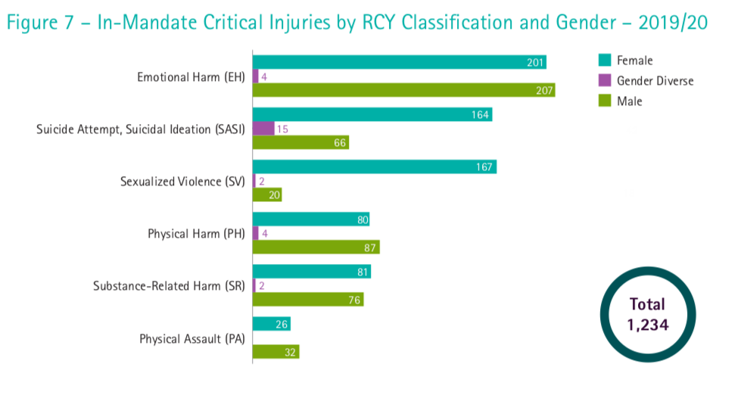
Presentation third page
Characteristics of Reportables

Slide 26
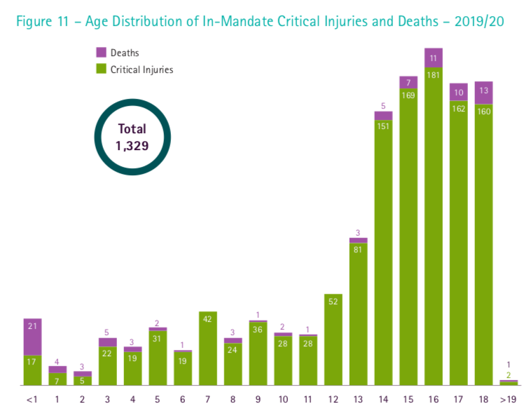

Slide 27
Spotlight: Monitoring
How can supports and services provided by government be improved to help children and youth achieve good outcomes?
How can we understand and respond to the involvement of child welfare in the lives of First Nations, Métis, Inuit and Urban Indigenous children and youth and families?
How well is MCFD accomplishing its goals to reduce the numbers of children and youth in care by focusing on meaningful and culturally appropriate approaches to permanency?
What do young people say about the supports they receive? How effective are these services from their experience?
How are the public bodies effecting change as a result of RCY recommendations?

Slide 28
Spotlight: Corporate Services
Finance
Human Resources
Information and Technology
Shared Services
Communications

Slide 29
Recruitment Process
Applications accepted to June 13th
Initial screening – those who have demonstrated in their application that they meet the core requirements of the position will proceed
Deeper review by selection panel; assessment of qualifications, experience, written work
Selection of people who will be invited to an interview
Invitation to in-person interview with members of the RCY and external community partners and selection of top candidates – late June
If several very strong candidates: Top candidates invited to visit RCY and meet with members of executive, staff – opportunity for 2-way assessment of fit;
Invitation to final meeting with Representative
Recommendations brought forward, references checked, offer made
Anticipated start date- mid August

Slide 30
Website: www.rcybc.ca

Slide 31
Questions about the role or recruitment process may be directed to Linda Shout, Linda.Shout@rcybc.ca

