Slide 1
Informational Webinar
RCY Systemic Review and Research Opportunities

Slide 2
About the RCY
Independent Officer reporting to the Legislative Assembly
Three primary statutory functions
Individual advocacy – children, youth and young adults up to age 27 receiving or eligible for designated services
Reviews and investigations – children and youth receiving reviewable services
Monitoring (systemic advocacy)

Slide 3
From Annual Report and Service Plan 2022/23, pp. 52-53

Slide 4
Statutory Authority
RCY mandate for investigations (RCY Act s.12)
Authority to compel participation and disclosures (s. 14)
Establishment of multidisciplinary team (Circle of Advisors) (s.15)
Consultation, disclosure and recommendations (s. 15.1)
Reports (s. 16)
Systemic reviews and reports (s.20)
Notes:
12 (1)The representative may investigate the critical injury or death of a child if, after the completion of a review of the critical injury or death of the child under section 11, the representative determines that
(a)a reviewable service, or the policies or practices of a public body or director, may have contributed to the critical injury or death, and
(b)the critical injury or death
(i)was, or may have been, due to one or more of the circumstances set out in section 13 (1) of the Child, Family and Community Service Act,
(ii)occurred, in the opinion of the representative, in unusual or suspicious circumstances, or
(iii)was, or may have been, self-inflicted or inflicted by another person.
Power to compel persons to answer questions and order disclosure
14 (1)For the purposes of an investigation under this Part, the representative may make an order requiring a person to do either or both of the following:
(a)attend, in person or by electronic means, before the representative to answer questions on oath or affirmation, or in any other manner;
(b)produce for the representative a record or thing in the person's possession or control.
(2)The representative may apply to the Supreme Court for an order
(a)directing a person to comply with an order made under subsection (1), or
(b)directing any officers and governing members of a person to cause the person to comply with an order made under subsection (1).
Multidisciplinary team
15 In accordance with the regulations, the representative may establish and appoint the members of a multidisciplinary team to provide advice and guidance to the representative respecting the reviews and investigations of critical injuries and deaths of children conducted under this Part.
Consultation, disclosure and recommendations
15.1 (1)At any time during or after an investigation under section 12, the representative may consult with a public body, director or person the representative considers appropriate in relation to the critical injury or death of the child.
(2)If during an investigation under section 12 the representative receives a request for consultation from a public body or director, the representative must consult with the public body or director in relation to the critical injury or death of the child.
(3)If consulting with a public body, director or person under this section, the representative may
(a)disclose to the public body, director or person the personal information the representative considers necessary and appropriate, and
(b)make recommendations to the public body or director, or to another public body or director, to improve the effectiveness and responsiveness of a reviewable service.
Reports after reviews and investigations
16 (1)The representative may aggregate and analyze the information received from the reviews and investigations conducted under sections 11 and 12 and produce a report of the aggregated and analyzed information that does not contain information in individually identifiable form.
(2)The representative must provide a report made under subsection (1) to the following:
(a)the standing committee;
(b)the public body, or the director, responsible for the provision of a reviewable service that is a subject of the report;
(c)any other public body, director or person that the representative considers appropriate.
(3)After an investigation of the critical injury or death of a child under section 12, the representative must make a report on the individual critical injury or death of the child.
(4)A report made under subsection (3) must contain the representative's reasons for undertaking the investigation and may contain the following:
(a)recommendations for
(i)the public body, or the director, responsible for the provision of a reviewable service that is a subject of the report, or
(ii)any other public body, director or person that the representative considers appropriate;
(b)personal information, if, in the opinion of the representative,
(i)the disclosure is necessary to support the findings and recommendations contained in the report, and
(ii)the public interest in the disclosure outweighs the privacy interests of the individual whose personal information is disclosed in the report;
(c)any other matters the representative considers relevant.
(5)A report made under subsection (3) may be provided to any person that the representative considers appropriate and must be provided to
(a)the standing committee,
(b)the public body, or the director, responsible for the provision of a reviewable service that is a subject of the report, and
(c)the public body, or the director, that is a subject of recommendations in the report, if not already provided the report under paragraph (b).

Slide 5
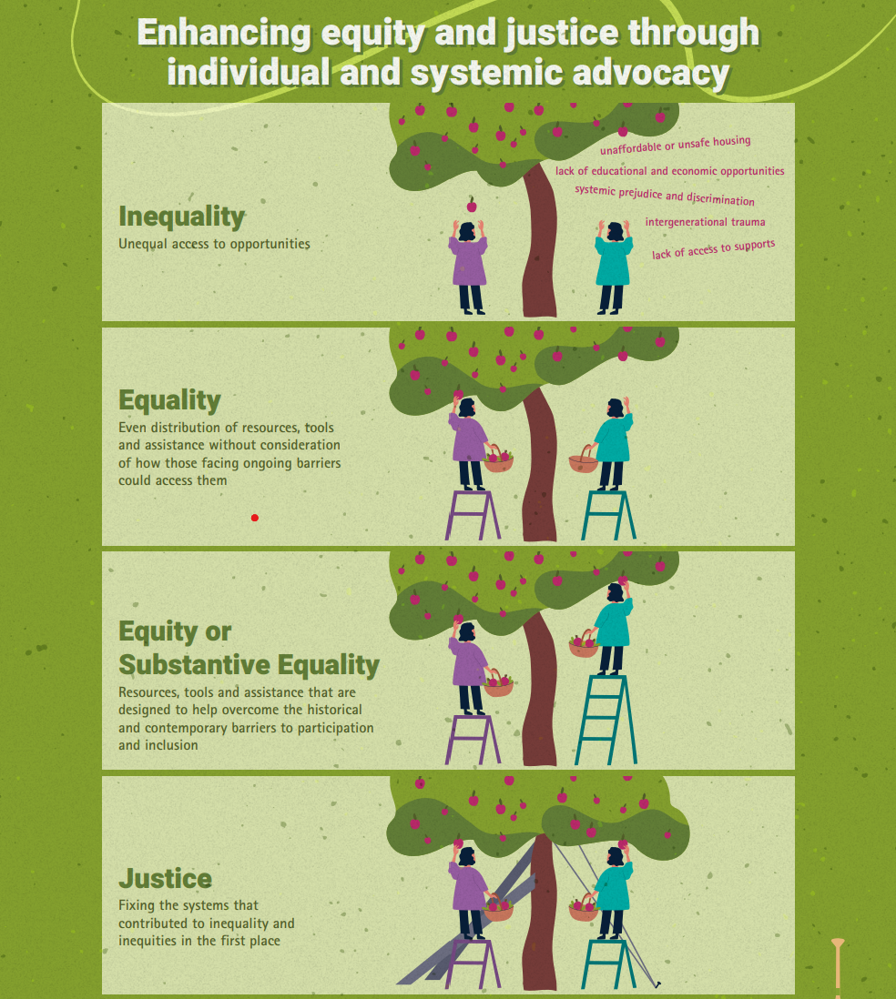
Ethical Responsibility
Individual stories illuminate inequities, patterns and trends that are causing harm to children, youth and young adults.
RCY’s role is to better understand what is contributing to and perpetuating the inequities, identify opportunities for improvement at individual, program, policy, legislative and systemic levels

Slide 6
Braiding Approach
Three strands of work
Child death investigation and reviews
Systemic review – illuminating the systemic and structural factors that may have contributed to the deaths and injuries
Convening and sensemaking
Indigenous methodologies; Two-eyed seeing

Slide 7
Ways of Being:
Truthtelling
Empathy
Brave
Respectful
Decolonized
Roles:
Steering Committee
Elder and Matriarch Advisors
Advisory Circles
Investigation team
Hub leads and teams
Contract support
Workforce Capacity - Recruitment, Experience, Training, Supervision and Retention
Other Areas of Concern Arising e.g., Parental MH and SU, COVID
Family Violence and Systems Response and Historical Impact
Inter-agency Practices- Communication, Coordination and Planning (school, hospital, medical)
Child Welfare Policies, Procedures and Responsiveness
Children and Youth with Special Needs/Complex needs
Family and Caregiver Support - Practice and Policy
Keeping Families Safely Together
Jurisdiction, Indigenous Child Welfare including Transitional Decision-making
Children’s Stories
Truth-Telling
Out of Care and Extended Family Care Options
Quality of Care/Quality Assurance
Historical and contemporary context:
Colonization, systems design, past reports and recommenda-tions, intersectionality
Child welfare systems reform
Notes:
Reference Touchstones of Hope

Slide 8
Research Opportunities
History of child welfare in B.C. and Canada, including an identification and analysis of key reports that address the need for practice reform or systems change.
Jurisdiction, Indigenous child welfare and transitional decision-making.
Workforce capacity, including recruitment, diversity and inclusion, onboarding, deployment, experience, diversity, training, caseloads, supervision, retention, and supports and guidance when working with Indigenous communities and leadership.
Child welfare policies, procedures, standards, and guidelines including clarity, responsiveness, cultural attunement, promising practices, and compliance.
Inter-agency, inter-ministry and inter-sectoral practices including communications and information-sharing, coordination, planning, responsibility, and responsiveness (e.g., across education, health care, policing, victims’ services, justice, and child welfare systems).

Slide 9
Research Opportunities
Out-of-Care and Extended Family Care including criteria for use, promising practices, preparation and decision-making, quality of care, communications, support, monitoring, and child outcomes.
Family and caregiver supports and interventions to prevent protective services involvement, enhance family capacity and/or restore family connections, with particular attention to promising practices where there are parental substance use and mental health concerns.
Child welfare systems reform, including identification and analysis of reform or transformation initiatives in other jurisdictions, key elements, and outcomes.
Intimate partner and family violence including assessments of risk, supports to parents leaving violence, community and policing responses to violence, counselling, and support.

Slide 10
Deliverables
Research paper and annotated bibliography that addresses:
A summary and analysis of the contemporary academic and grey literature on the topic (past 5 years);
An overview of the existing knowledge base about the topic, with particular attention to Indigenous perspectives and knowledge;
An interjurisdictional scan to identify promising initiatives, policies, and practices in other jurisdictions within Canada, New Zealand, Australia and the United Kingdom; and,
Based on the literature and interjurisdictional scan, a summary of opportunities for reform and transformation relevant to the topic.

Slide 11
Process
Upon qualification RCY will work with consultant/researcher to determine which areas of work and contract terms
Each area of review will have a project lead and advisors to work with the researcher, regular touchpoints and respond to queries
Each researcher will also be engaged in1-2 meetings with circle of advisors/subject matter experts, researchers from other hub teams and possibly ‘sense-making’ sessions

Slide 12
Expectations
Related research and analytical experience either with key topics or related areas
Strong writing with attention to detail and timelines
Openness to centring Indigenous ways of knowing and being and two-eyed seeing (support and guidance will be provided)
Collaborative and consultative spirit

Slide 13
Selection Criteria
2-3 page submission
Proponent's research background, skills and experience.
Proponent’s previous work on any or all of the research topics noted above.
Capacity to undertake the work within tight timelines.
Hourly rate.

Slide 14
Timelines
December 12 – Initial Intake to qualified suppliers
December 15 – Notifications
December 18-31- Contract negotiations
January 31- Final intake to qualified suppliers list
February 28 – Draft special topic report to RCY
March 15 – Feedback from RCY
April 15 – Final report due to RCY
June 30 – Release of investigation and systemic review report by RCY

