Slide 1

Custom Adoption: Challenge, Opportunity and Reconciliation
Presented by: Kwulasultun (Douglas White III) BA, JD
Director, Centre for Pre-Confederation Treaties
and Reconciliation
A Forum for Change: Reconciliation for Today’s First Nations, Metis & Aboriginal Children Through Custom Adoption and Lifelong Family and Tribal Connections
April 16, 2015
Nanaimo Conference Centre

Slide 2
Overview
The Challenge We Must Address
The Doctrine of Continuity
Overview of Common Law of Custom Adoption
  What is Custom Law?
  History of Recognition of Custom Adoption in Courts
Overview of Legal Provisions Recognizing Custom Adoption
Adoption as Indigenous Tradition?
Duties of Indigenous Peoples to Children
Rights of Indigenous Peoples to Children
Occupying the Field
  Custom Adoption
  Jurisdiction
  The American Example
Conclusion

Slide 3
The Challenge We Must Address:
Intergenerational Crisis
 | "2007/08" | "2008/09" | "2009/10" | "2010/11 " | "2011/12“ (Dec. 2011)
"Children in Care at Year End" | 9237 | 8959 | 8528 | 8373 | 8187
"Aboriginal Children in Care at Year End" | 4788 | 4681 | 4643 | 4630 | 4584
"Total Aboriginal Child Population" | 73842 | 74203 | 74533 | 74384 | 74715
"Data Source: Management Information System and Social Work System. Aboriginal population data is from BC Stats Aboriginal Identity Projection Model (medium scenario). BC Child population from PEOPLE 36."

Slide 4
The Challenge We Must Address:
Intergenerational Crisis cont’d
Sources of Crisis:
Displacement and Erosion of Authority
Displacement of Cultural and Social Meanings of Child, Parent, Family
Indian Act
Residential School, 60s Scoop, Ongoing Systemic Racism
Grinding Multi-generational Poverty, Addictions and Mental Health Issues
Violence Against Women
Violence Against Children
Political Failure on the part of Federal, Provincial and First Nations Governments
Lack of Strategy, Plan, Implementation
Lack of Capacity

Slide 5
The Challenge We Must Address:
Intergenerational Crisis cont’d
Sources of Hope:
Tsawwassen Accord, First Nations Advocacy, First Nations Entities
Jordan’s Principle, Federal Apology, Truth and Reconciliation Commission
Recognition and Reconciliation Protocol on First Nations Children, Youth and Families (2009)
BC Representative for Children and Youth, MCFD and Initiatives Toward Change
UN Declaration on the Rights of Indigenous Peoples (2007), Convention on the Rights of the Child (1989), Declaration of the Rights of the Child (1959)
s. 35(1) of the Constitution Act, 1982 recognition and affirmation of Aboriginal rights
Splatsin “A By-law For The Care of Our Indian Children: Spallumcheen Indian Band By-law #3-1980”
The concept of Duty to, and orientation toward, Future Generations in the Tsilhqot’in Nation decision
Recognition of Custom Adoption by courts and in Adoption legislation

Slide 6
The Challenge We Must Address:
Intergenerational Crisis cont’d
The Role of Legal Process in Addressing Challenge
The Law and Legal Process is a necessary part of a solution
But, the Law is not enough by itself
This kind of crisis requires a multi-dimensional comprehensive strategy
  Political
  Legal
  Social
Adoption implicates and operates in all of these dimensions
Having said all of this, adoption is grounded in recognizing and achieving changed legal relations between parents, children and communities – so the legal process has a heightened role

Slide 7
The Doctrine of Continuity
The history of the interface of Europeans and the common law with aboriginal peoples is a long one. As might be expected of such a long history, the principles by which the interface has been governed have not always been consistently applied. Yet running through this history, from its earliest beginnings to the present time is a golden thread -- the recognition by the common law of the ancestral laws and customs [of] the aboriginal peoples who occupied the land prior to European settlement.
Justice McLachlin in dissent, in R. v. van der Peet, [1996] 2 S.C.R. 507, at para. 263.

Slide 8
The Doctrine of Continuity
Campbell v. British Columbia (Attorney General), 2000 BCSC 1123
If it need be said, the common law will be enforced by the courts. The common law has long recognized 'customs' or rules that have obtained the force of law in a particular locality. Agreements such as treaties negotiated and entered into by exercise of executive prerogative will be enforced by the courts.
History, and a review of the authorities, persuades me that the aboriginal peoples of Canada, including the Nisga'a, had legal systems prior to the arrival of Europeans on this continent and that these legal systems, although diminished, continued after contact. Aboriginal laws did not emanate from a central print oriented law-making authority similar to a legislative assembly, but took unwritten form. Lord Denning, in R. v. Secretary of State For Foreign and Commonwealth Affairs at p. 123 likened aboriginal laws to 'custom':
  These customary laws are not written down. They are handed down by tradition from one generation to another. Yet beyond doubt they are well established and have the force of law within the community.

Slide 9
Overview of Common Law of Custom Adoption
What is Custom Law?
A custom is a particular rule which has existed either actually or presumptively from time immemorial, and has obtained the force of law in a particular locality, although contrary to or not consistent with the general common law of the realm. As regards the matter to which it relates, a custom takes the place of the general common law, and is in respect of that matter the local common law within the particular locality where it obtains. Custom is unwritten law peculiar to particular localities.
A custom exists in a particular locality only in respect of some particular matter or matters; other matters within the same locality are governed by the general common law.
Halsbury’s Laws of England, Vol 11, 3rd ed (London, UK: Butterworth, 1955) at 158, para 294.

Slide 10
Overview of Common Law of Custom Adoption
Four Essential Elements of Custom Law
A custom to be valid must have four essential attributes. First, it must be immemorial; secondly, it must be reasonable; thirdly, it must have continued without interruption since its immemorial origin; and, fourthly, it must be certain in respect of its nature generally, as well as in respect of the locality where it is alleged to obtain and the persons whom it is alleged to affect. These characteristics are the necessary corollaries of the definition of a custom as being local common law, and they serve a practical purpose as rules of evidence when the existence of a custom is to be established or refuted.
Ibid at 160, para 299.

Slide 11
Overview of Common Law of Custom Adoption
Four Essential Elements of Custom Law cont’d
1. Immemorial Existence
Every custom must have been in existence from a time preceding the memory of man, a date which has long been fixed at the year 1189, the commencement of the reign of Richard I. Where, however, it is impossible to show such a continued existence, the courts will support the custom if circumstances are proved which raise a presumption that the custom in fact existed at that remote date. Evidence showing continuous user as of right as far back as living testimony can go is regarded as raising this presumption.
Ibid at 160-161, para 300.

Slide 12
Overview of Common Law of Custom Adoption
Four Essential Elements of Custom Law cont’d
2. Reasonableness
A custom must be reasonable. If it is against reason it has no force in law. The reason here referred to is not to be understood as meaning every unlearned man’s reason, but artificial and legal reason warranted by authority of law. Since every custom sanctioned by the court’s must be reasonable, it follows that every case where a custom has been upheld by the courts is an example of a reasonable custom. Each case, of course, depends upon its own peculiar facts, and no hard and fast rule can be laid down.
Ibid at 162, para 302-305.

Slide 13
Overview of Common Law of Custom Adoption
Four Essential Elements of Custom Law cont’d
3. Certainty
A custom must be certain. Not only should the custom as alleged point out clearly and certainly the principle or rule of the custom, but that principle or rule so pointed out must be one which is definite and certain, so that by the application of it to each particular case it may be shown with certainty what are the rights which the custom gives in that case. A custom must also be certain in respect of the locality where it is alleged to exist; for every custom must be local, and cannot be alleged as existing throughout the whole realm. A custom must be certain in respect of the persons or classes of persons whom it is alleged to affect.
Ibid at 164, para 308-310.

Slide 14
Overview of Common Law of Custom Adoption
Four Essential Elements of Custom Law cont’d
4. Continuity
A custom to be valid must have continued without interruption since time immemorial. There must be long, continuous, habitual usage.
Ibid at 167, para 311.

Slide 15
Overview of Common Law of Custom Adoption
Proof of Custom Law
All customs of which the courts do not take judicial notice must be clearly proved to exist – the onus of establishing them being upon the parties relying upon their existence. In proving an immemorial custom, the usual course taken is to call persons of middle or old age to state that in their time, usually at least half a century, the custom has always prevailed. This is considered, in the absence of countervailing evidence, to show that the custom has existed for all time.
Ibid at 171, para 319-320.

Slide 16
Custom Adoption
In Canada, the legal relationship known as adoption is a status created by statute. However, for many years, courts in Canada have recognized the legal validity of aboriginal customary adoptions. See Re Katie (1961), 32 D.L.R. (2d) 686 (N.W.T. Terr. Ct.); Re Beaulieu (1969), 3 D.L.R. (3d) 479 (N.W.T. Terr. Ct.); Re Deborah (1972), 28 D.L.R. (3d) 483 (N.W.T.C.A.), upholding (1972), 27 D.L.R. (3d) 225 (N.W.T.S.C.); Re Wah-Shee (1975), 57 D.L.R. (3d) 743 (N.W.T.S.C.); Re Taqornak (1983), 50 A.R. 237 (N.W.T.S.C.); McNeil v. MacDougal [2000] 2 W.W.R. 729 (Alta. Sur. Ct.); Manychief v. Poffenroth [1995] 3 W.W.R. 210 (Alta. Q.B.); Re B.C. Birth Registration No. 1994-09-040399 (1998) 45 R.F.L. (4th) 458 (B.C.S.C.); Prince v. Duncan [2000] 4 C.N.L.R. 249 (B.C.S.C.); and Casimel v. I.C.B.C. (1993) 106 D.L.R. (4th) 720 (B.C.C.A.).

Slide 17
Custom Adoption
In the Northwest Territories there are adoptions in accordance with the Adoption Ordinance, adoptions in accordance with Indian custom and adoptions in accordance with Eskimo custom.
The Eskimos, and particularly those in outlying settlements and distant camps, are clinging to their culture and way of life which they have found to be good. These people are in process of cultural change and have a right to retain whatever they like of their culture until they are prepared of their own free will to accept a new culture. In particular, although there may be some strange features in Eskimo adoption custom which the experts cannot understand or appreciate, it is good and has stood the test of many centuries and these people should not be forced to abandon it and it should be recognized by the Court.
Re Katie (1961), 32 D.L.R. (2d) 686 (N.W.T. Terr. Ct.), paras. 9, 13.

Slide 18
Custom Adoption
In Re Tagornak Adoption Petition [1984] 1 C.N.L.R. 185 (N.W.T.S) Marshall J. reviewed the same cases and stated:
Having reviewed the authorities, certain concepts emerge. The Court's role is declaratory, certifying that an adoption by native custom has indeed taken place. Some of the criteria which the Court will apply to the case before it are:
that there is consent of natural and adopting parents;
that the child has been voluntarily placed with the adopting parents;
that the adopting parents are indeed native or entitled to rely on native custom; and
that the rationale for native custom adoptions is present in this case as in Re Deborah, [1999] S.C.C.A. No. 117, above.
[The specific rationale in Re Deborah was that adoption outside the statute was necessary for the survival or care of Eskimo children whose parents were unable to care for them or who had died.]

Slide 19
Custom Adoption
Justice Grist, in B.C. Birth Registration No 1994-09-040399,Re, [1998] 4 C.N.L.R. 7 (B.C.S.C.) – the only reported case dealing with a s.46 order under the BC Adoption Act - adopted the four Tagornak factors and added a fifth:
  The fourth factor, the requirement that the "rationale for native custom adoption" be present would appear to mean that there is a recognized reason within the scope of the custom, whether it be to provide for children without parents, or otherwise, for the adoption to take place.
  In the case at bar, the birth mother is a young woman who decided that it would be best for her child that all parental rights and responsibilities be assumed by the Petitioners. The affidavit material indicates that this is a recognized reason for adoption within Carrier custom.
  In addition to these factors, I would add that it appears important to the process of recognition of customary adoption, that the relationship created by custom must be understood to create fundamentally the same relationship as that resulting from an adoption order under Part 3 of the Act.

Slide 20
Legal Provisions Recognizing Custom Adoption
Adoption Act, RSBC 1996, c 5
Custom adoptions
46 (1) On application, the court may recognize that an adoption of a person effected by the custom of an Indian band or aboriginal community has the effect of an adoption under this Act.
(2) Subsection (1) does not affect any aboriginal rights a person has.
Indian Act, RSC 1985, c I-5
2. (1) In this Act, …
“child” includes a legally adopted child and a child adopted in accordance with Indian custom;

Slide 21
Duties of Indigenous Peoples in relation to Children
UN Convention on the Rights of the Child
Article 4 “Governments have a responsibility to take all available measures to make sure children’s rights are respected, protected and fulfilled.”
  When Parents are unable to Parent, what duties do First Nations have in relation to parenting and seeking reconciliation?
  The Duty and Obligation to Future Generations
  Sacred Duty of Indigenous Peoples to Undertake Work to Overcome History of Alienation
  How can they be upheld?
  Customary Indigenous Law of Adoption is a manifestation of the Right of Self-Government that is constitutionally recognized and protected
  Utilizing Authority of Our Peoples to Repair Damage, to Protect Families, to Care for Children

Slide 22
Rights of Indigenous Peoples in relation to Children
UN Declaration on Rights of Indigenous Peoples
… Recognizing in particular the right of indigenous families and communities to retain shared responsibility for the upbringing, training, education and well-being of their children, consistent with the rights of the child, …
Article 3: Indigenous peoples have the right to self-determination. By virtue of that right they freely determine their political status and freely pursue their economic, social and cultural development.
Article 4: Indigenous peoples, in exercising their right to self-determination, have the right to autonomy or self-government in matters relating to their internal and local affairs, as well as ways and means for financing their autonomous functions.
Article 7: 1.Indigenous individuals have the rights to life, physical and mental integrity, liberty and security of person. 2. Indigenous peoples have the collective right to live in freedom, peace and security as distinct peoples and shall not be subjected to any act of genocide or any other act of violence, including forcibly removing children of the group to another group.

Slide 23
Rights of Indigenous Peoples in relation to Children
UN Declaration on Rights of Indigenous Peoples
Article 8
1. Indigenous peoples and individuals have the right not to be subjected to forced assimilation or destruction of their culture.
2. States shall provide effective mechanisms for prevention of, and redress for:
(a) Any action which has the aim or effect of depriving them of their integrity as distinct peoples, or of their cultural values or ethnic identities;
…
(c) Any form of forced population transfer which has the aim or effect of violating or undermining any of their rights;
(d) Any form of forced assimilation or integration; …
Article 9
Indigenous peoples and individuals have the right to belong to an indigenous community or nation, in accordance with the traditions and customs of the community or nation concerned. No discrimination of any kind may arise from the exercise of such a right.

Slide 24
Rights of Indigenous Peoples in relation to Children
Statutory Rights of First Nations
Adoption Act, RSBC 1996, c 5.
Discussion with aboriginal communities
7 (1) Before placing an aboriginal child for adoption, a director or an adoption agency must make reasonable efforts to discuss the child's placement with the following:
[First Nations Designated Representatives]
(2) Subsection (1) does not apply
(a) if the child is 12 years of age or over and objects to the discussion taking place, or
(b) if the parent or other guardian of the child who requested that the child be placed for adoption objects to the discussion taking place.
Minister's authority to make agreements
76 For the purposes of this Act, the minister may make an agreement with any of the following:
(a) any Indian band or a legal entity representing an aboriginal community;
(a.1) the Nisga'a Nation or a Nisga'a Village;
(a.2) a treaty first nation;

Slide 25
Rights of Indigenous Peoples in relation to Children
Right of Self-Government under s. 35(1)
Corrigan Estate (Re), 2013 MBQB 77
Menzies J.
20 There is evidence that aboriginal customary adoptions were still being practised at Standing Buffalo First Nation in the 1960's, and the absence of any evidence the custom has ceased satisfies me the aboriginal right of customary adoption was in existence as of 1982 and is therefore constitutionally recognized by virtue of s.35 (1).

Slide 26
Occupying the Field
Just Do It: Implement, Implement, Implement Custom Adoption
Make Use of Statutory Rights
Build Understanding with Other Governments
Build on existing framework agreements
Seeking Amendments to Legislation

Slide 27

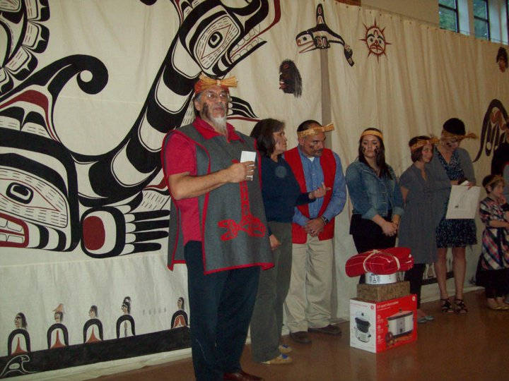
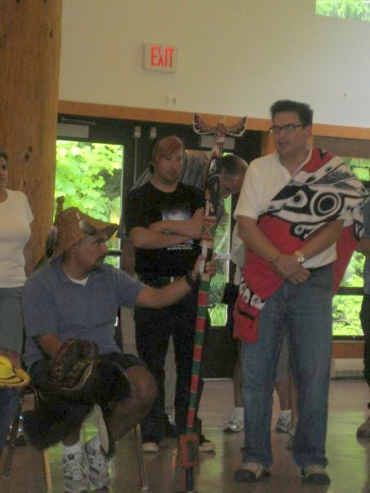
My Eldest Brother, Joel

Slide 28
Hycep’ka Siem
Kwulasultun (Douglas White III), BA, JD
Director
Centre for Pre-Confederation Treaties and Reconciliation
Vancouver Island University douglas.white@viu.ca | 250.756.7563

